Slide 1

Member names: Eric Frankel, Tommy Gao,
Tyler Zhu, Yi Zu
Challenges: AngelHack, Code for Cause, Consensys, Trulioo
Problem: Homeless people without legal documents have limited accessibility to food from local food banks.

Slide 2
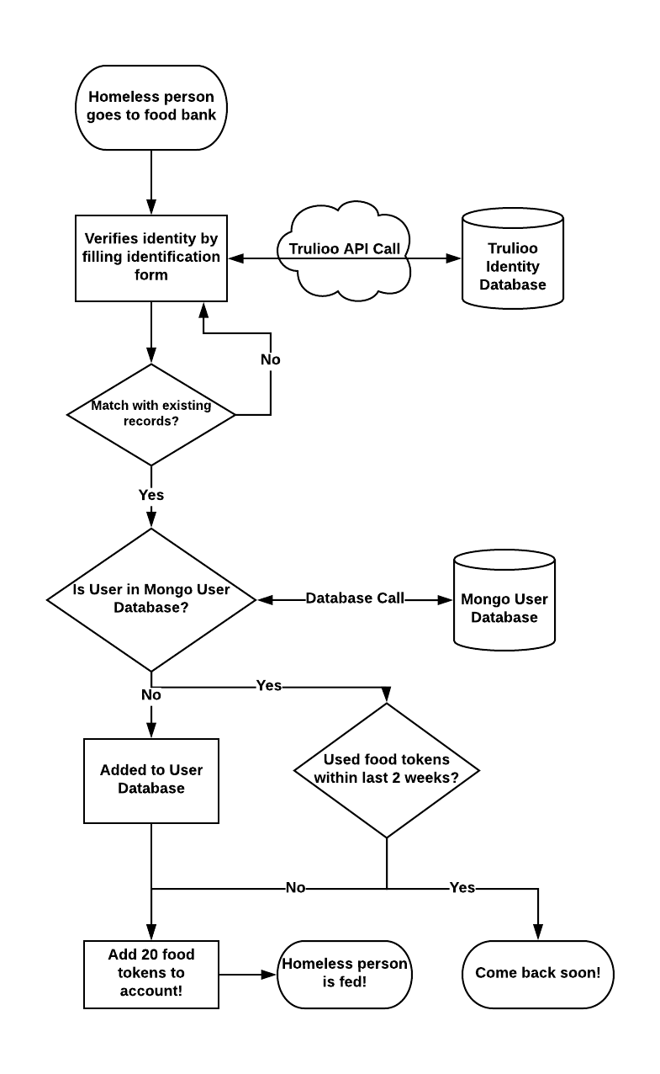
VeriFood Process Flow
“To increase accessibility to local food banks through digital identification”
- VeriFood Mission Statement
Notes:
Talk about potential target market: local city councils, non-profit companies trying to mitigate the homeless problem

